Slide 1
Nexthike it solution
Title : Data acquisition and data wragling
Sub Title : “Transforming raw data into actionable insights”
Name : Dhruv godhasara
date : 20/03/2025

Slide 2
What is data acquisition
Data Acquisition (DAQ) is the process of collecting, measuring, and analyzing real-world data from various sources and converting it into a digital format for processing and analysis. It plays a crucial role in fields like industrial automation, healthcare, environmental monitoring, and scientific research.
Process of collecting data from various sources
Can be structured (databases, CSV files) or unstructured (text, images, web data)
Sources: APIs, Web Scraping, Databases, IoT Devices

Slide 3
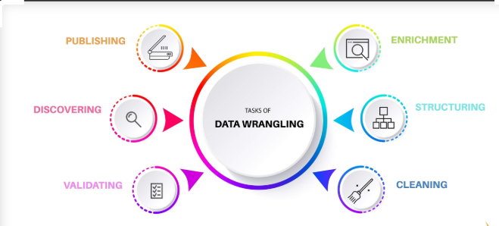
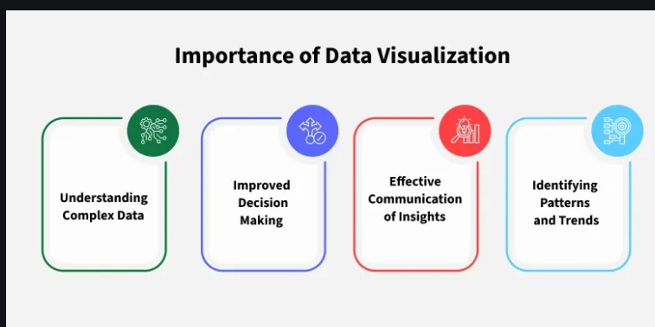
Data Wragling
Data Visulization

Slide 4
Steps in Data Acquisition
Identify the Data Source
Extract the Data
Load the Data into a Suitable Format
Validate the Data

Slide 5
Data acquisition challenges
Data Quality Issues – Incomplete, inconsistent, or inaccurate data.
Data Integration – Combining data from multiple sources with different formats.
High Costs – Expensive hardware, software, and storage.
Security & Privacy – Compliance with regulations like GDPR.
Scalability – Handling large and growing datasets efficiently.
Latency & Speed – Ensuring real-time data collection and processing.
Hardware Limitations – Sensor failures, connectivity issues, and power constraints.
Ethical Concerns – Bias and misuse of collected data.

Slide 6
What is data wraggling
Data Wrangling (also called Data Munging) is the process of cleaning, transforming, and structuring raw data for analysis.
Ensures data quality, consistency, and usability.
Essential for data-driven decision-making and machine learning.

Slide 7
Importance of Data Wrangling
Enhances data accuracy and reliability.
Saves time for data analysts and scientists.
Improves insights and decision-making.
Facilitates better machine learning model performance.

Slide 8
Steps in Data Wrangling
Data Collection – Gathering raw data from multiple sources.
Data Cleaning – Handling missing values, removing duplicates, and fixing inconsistencies.
Data Transformation – Converting data into a structured format.
Data Enrichment – Adding new relevant information from external sources.
Data Validation – Checking data integrity and consistency.
Data Structuring – Organizing data for efficient analysis.

Slide 9
Tools for Data Wrangling
Programming Languages: Python (Pandas, NumPy), R (dplyr, tidyr)
Data Wrangling Software: Trifacta, OpenRefine, Alteryx
Databases: SQL, Google BigQuery
Spreadsheets: Excel, Google Sheets

Slide 10
Real-World Applications
Finance: Fraud detection and risk assessment.
Healthcare: Cleaning patient records for accurate diagnosis.
Marketing: Customer segmentation and trend analysis.
Machine Learning: Preparing datasets for model training.

Slide 11
Common Issues in Data Wrangling
Missing or incomplete data.
Inconsistent data formats.
Duplicate records.
Outliers and anomalies.
Unstructured data formats.

Slide 12
Data visulization
Data visualization translates complex data sets into visual formats that are easier for the human brain to understand. This can include a variety of visual tools such as:
Charts: Bar charts, line charts, pie charts, etc.
Graphs: Scatter plots, histograms, etc.
Maps: Geographic maps, heat maps, etc.
Dashboards: Interactive platforms that combine multiple visualizations.

Slide 13
Conclusion
Data wrangling is crucial for accurate and meaningful data analysis.
Proper tools and techniques help streamline the process.
Automation and AI-driven tools are improving data wrangling efficiency.

Slide 14
Thank you

